Slide 1
An Introduction to
Roz Gittins, Director of Pharmacy
Steve James, Operations Director NW

Slide 3
Eligibility criteria
Any person who identifies as having a support need can access the service and will receive treatment
The service adopts a no wrong door approach to access and the level of treatment delivered will be individualised to the persons needs
The full service is offered across the whole county
Cumbria Recovery Steps is a fully integrated addictions service
Service user can be referred into the service by:
Self
Professional
Family/friend/carer
Other
Referral form on PharmOutcomes

Slide 4
Service Model
Active system leaders and development of Cumbria Addictions Strategy
HOPE
Health Prevention, Education, IAG, BI/EBI and Hospital Liaison
Assessment and Care Planning
Comprehensive multi agency assessment, asset based, trauma aware, accessible services
Recovery Coordination and Case Management
PSIs, substance specific pathways, aftercare, radical help, holistic support, Family/Community at the heart of recovery, Counsellors
Peer Support
Visible lived experience recovery, peer mentoring, community based recovery/quasi rehab
Notes:
Emphasis that we recognise the value of shared care and ensured that it was part of our model

Slide 5
Service Model
Clinical
Prescribing, detox, relapse prevention, supervised consumption, BBV, wound care, Needle Syringe Provision, Naloxone training/provision, Shared Care Provision, expanding community based delivery/pharmacies
Criminal Justice
ATR/DRR, multi-agency care planning, prison link, Probation/IOM, integrated care planning, desistance, in reach into custody suites
Housing
Housing pathways, quasi rehab, Humankind RP
Capacity Building
Volunteer/apprentice/training pathway
Digital offer
Online Recovery, BreakingFree Online

Slide 6
Locations and contact details
1st Floor Stocklund House, Castle Street, Carlisle CA3 8SY
92-96 Duke Street, Barrow-in-Furness, Cumbria LA14 1RD
6 Finkle Street, Workington, Cumbria CA14 2AY
21b Lowther Street, Whitehaven, Cumbria CA28 7DG
Plus community venues including GP's, Penrith and Kendal
01900 512300
referrals@recoverystepscumbria.org.uk
Notes:
Experience of safely transitioning substantial SMS contracts - ensuring safe transition and continuity of care

Slide 7
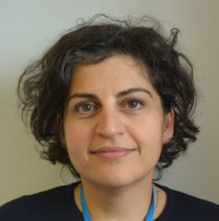
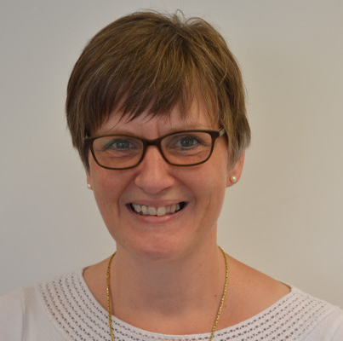
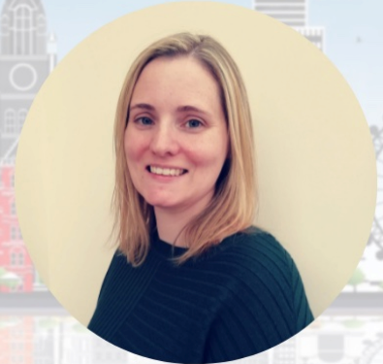
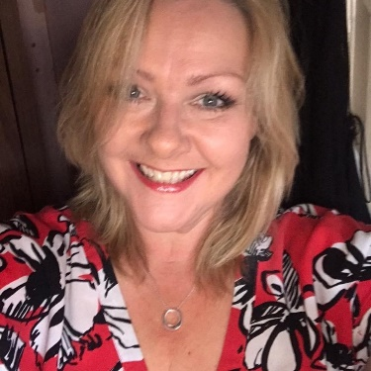
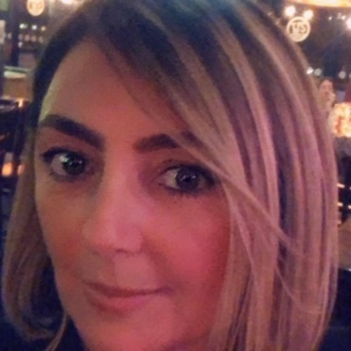
The Clinical Department
Dr Roya Vaziri Executive Medical Director and Responsible Officer
Anna Headley Executive Operations Director and Executive to the Clinical Department
Stacey Smith Director of Nursing
Roz Gittins Director of Pharmacy
Leesa Howes Director of Clinical Services
Emma Haigh Business Support Manager: Clinical Department and Leeds Regional Office
Paul Ford, Dr Joss Bray
Notes:
Clinical department introduction names but also add in
Roya to emphasise started in shared care- GP etc

Slide 8
NEW SLAs for SC and NSP (and THN)
NO changes to payments nb Espranor added
contracts@humankindcharity.org.uk

Slide 9
Things to remember:
Complete PO sign up module
CPPE DoC (Responsible Pharmacist - within 3 months)
Prompt notification if unable to offer the service
Automated PO 3 months cut off for payment
S/C: Should notify every time a dose is missed/where attendance is erratic. Must notify immediately if:
≥3 consecutive doses missed
Any titration doses missed
Any concerns about the dose/prescription
A dispensing error/near miss occurs
Presenting as intoxicated
Unacceptable behaviour
Whole dose not consumed
Concerns about physical/health care needs
Any concerns about diversion/safeguarding/risk

Slide 10
Prescribed Treatment Agreement

Slide 11
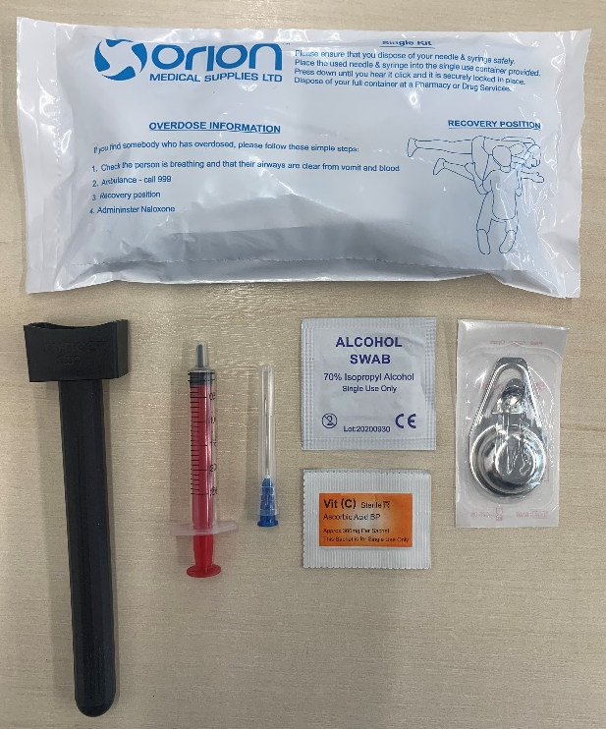
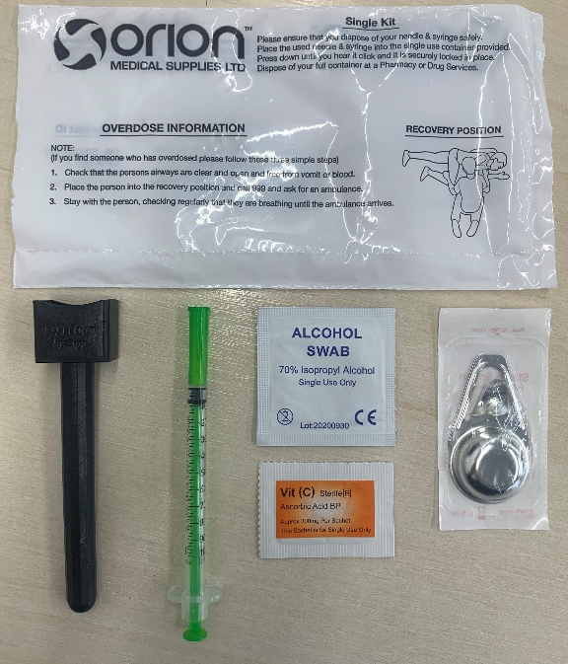
NSP Arrangements
- via Orion
- Paraphernalia nb Citric→Vit C and disposal
- Ordering arrangements
- Waste collection arrangements
THN EoI – NO requirement to offer S/C or NSP – BEFORE Fri 15th Oct

Slide 12
Quality Assurance Visits

Slide 13
ANY REQUESTS?!!!!
Training/CPD Updates

Slide 14
Questions & Answers

