Slide 1
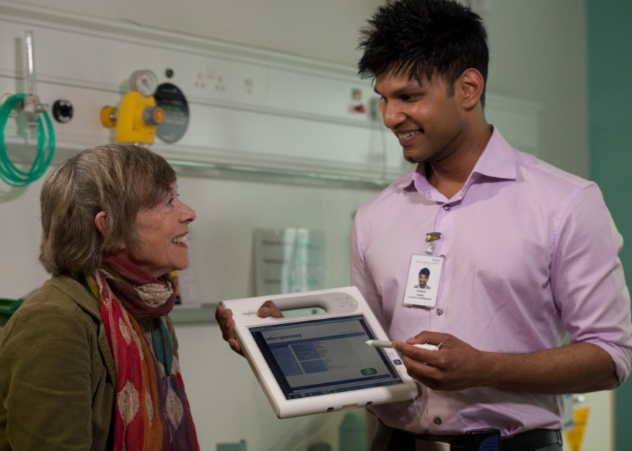


Alistair Gray, Clinical Services Lead Pharmacist
East Lancashire Hospitals NHS Trust
@ReferToPharmacy

Slide 2

Why refer to Community pharmacy?
New Medicine Service: ↑10% in medicines adherence
Discharge Medication Review: every £1 spent saves £3
Patient Safety: sharing the right information when it matters
↓Waste
↓ED attendance
↓(re)admissions
↑Safety
Notes:
Explain what these headlines mean

Slide 3
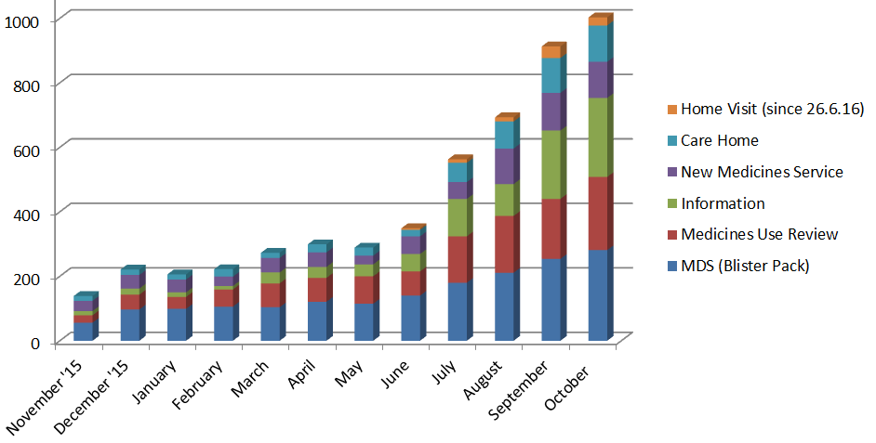
Refer-to-Pharmacy Referrals to Oct‘16
85% of all referrals are accepted by the community pharmacy

Slide 4
Refer-to-Pharmacy Facts
 |  | Number of referrals
Referrals made to date: 29 Oct 2015 – 31 Oct 2016 |  | 5176
Rolling Average Weekly Referrals (last 4wks) |  | 232
Best week to date | W/E 3/10/16 | 274
Best day to date | 3/10/16 | 67
Each community pharmacy receives two referrals per week on average
MDS referrals let community pharmacists know of changes for patients with existing Monitored Dosage Systems (Blister Packs)
To end of Sept 2016 | Number of referrals | Percentage
MDS (Blister Pack) | 1764 | 35%
Medicines Use Review | 1201 | 24%
Information | 890 | 15%
New Medicine Service | 709 | 14%
Care Home | 522 | 9%
Home Visit (since 26.6.16) | 90 | 2%

Slide 5
Refer-to-Pharmacy Outcomes
5 weeks to end of September
Readmissions | Referrals | %
Likely admission within 28 days (RiO 3) | 35 | 3.5%
Possible admission within 28 days (RiO 2) | 200 | 20%
No likelihood of admission (RiO 1) | 762 | 76.5%
Saved dispensing time | Referrals | %
No | 395 | 40%
Yes | 602 | 60%
Reduced waste | Referrals | %
No | 369 | 37%
Yes | 628 | 63%

Slide 6

% of readmissions for the same diagnosis
from medical wards: An early SIGNAL
Equates to 60 less people readmitted
in this 6 month period
Lord Carter says: £3,500/patient episode
Period | Readmissions at 28 days
January -July 2015 | 3.8%
January - July 2016 | 3.2%
Notes:
I’ll update this with live data closer to the time

Slide 7

Royal Pharmaceutical Society
Leadership in Pharmacy award 2016

Slide 8
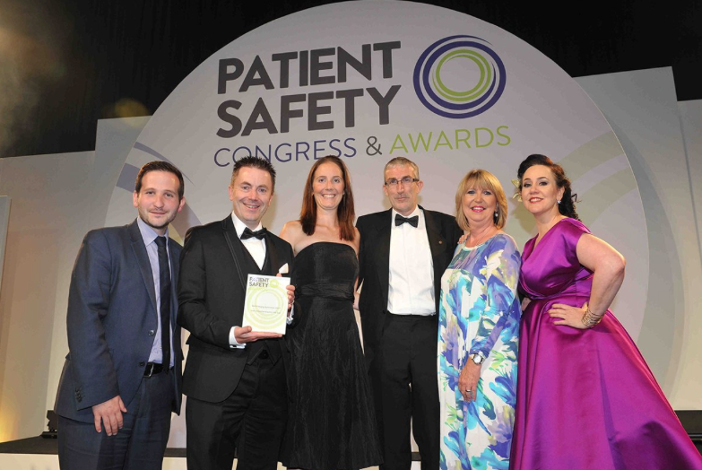
Patient Safety Award winner 2016
Best Emerging Technology or IT
delay

Slide 9

Building Better Healthcare winner 2016
Best Communications or IT product
delay

Slide 10


Next steps
Be advocates for a referral system where you work
Get in touch to arrange a scoping meeting
alistair.gray@elht.nhs.uk

